Slide 1
Drone Phenology Monitoring
Gaurav Rajput
Parth Thakur

Slide 2
Objective
Given two sets of crown polygons (OM3 and OM4)
OM3 is misaligned with respect to OM4
Goal: Affinely align OM3 to OM4 to maximize overlap (IoU)
Calculate A-B and B-A but with constraint

Slide 3


Crown Matching & Merging
Crowns from OM3 and OM4 were compared using an IoU threshold of 0.7
If IoU(OM3[i], OM4[j]) > 0.7 → crowns were merged via geometric union
The merged geometry replaced the original crowns in both OM3 and OM4
Merging Crowns Based on IoU

Slide 4
A−B and B−A Difference Computation
If an OM3 crown is larger than the overlapping OM4 crowns → it's likely OM4 is missing some parts → show A−B.
If the union of OM4 overlaps is larger, maybe OM4 overestimated → show B−A.
Difference Analysis with Area Constraint

Slide 5
Restoring Unmatched Crowns
After merging, some crowns exist in only one of the scenes
These were duplicated into the other crown set to preserve all trees
Ensures full crown set is preserved, even for unmatched crowns.
Handling Crowns with IoU ≈ 0 (Unmatched)

Slide 6
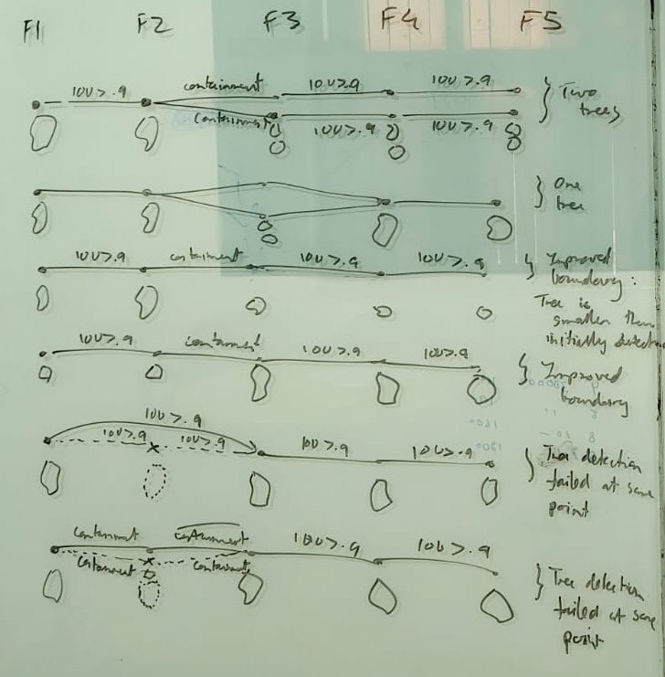
Challenge in Multi-Temporal Alignment
What I Did
I aligned OM4 crowns to OM3 (reference) using a translation/affine transformation.
Then tried aligning OM5 to the already-aligned OM4 crowns.
What Went Wrong
OM4 is no longer in its original coordinate system. It was shifted to match OM3.
OM5 crowns (in their native space) now try to align to transformed OM4, which introduces spatial inconsistencies.

Slide 7
Thank You

